Slide 1
UNIT-2 Data Preprocessing
Lecture Topic
**********************************************
Lecture-13 Why preprocess the data?
Lecture-14 Data cleaning
Lecture-15 Data integration and transformation
Lecture-16 Data reduction
Lecture-17 Discretization and concept hierarchgeneration

Slide 2
Lecture-13
Why preprocess the data?

Slide 3
Lecture-13 Why Data Preprocessing?
Data in the real world is:
  incomplete: lacking attribute values, lacking certain attributes of interest, or containing only aggregate data
  noisy: containing errors or outliers
  inconsistent: containing discrepancies in codes or names
No quality data, no quality mining results!
  Quality decisions must be based on quality data
  Data warehouse needs consistent integration of quality data
Lecture-13 Why Data Preprocessing?

Slide 4
Multi-Dimensional Measure of Data Quality
A well-accepted multidimensional view:
  Accuracy
  Completeness
  Consistency
  Timeliness
  Believability
  Value added
  Interpretability
  Accessibility
Broad categories:
  intrinsic, contextual, representational, and accessibility.
Lecture-13 Why Data Preprocessing?

Slide 5
Major Tasks in Data Preprocessing
Data cleaning
  Fill in missing values, smooth noisy data, identify or remove outliers, and resolve inconsistencies
Data integration
  Integration of multiple databases, data cubes, or files
Data transformation
  Normalization and aggregation
Data reduction
  Obtains reduced representation in volume but produces the same or similar analytical results
Data discretization
  Part of data reduction but with particular importance, especially for numerical data
Lecture-13 Why Data Preprocessing?

Slide 6

Forms of data preprocessing
Lecture-13 Why Data Preprocessing?

Slide 7
Lecture-14
Data cleaning

Slide 8
Data Cleaning
Data cleaning tasks
  Fill in missing values
  Identify outliers and smooth out noisy data
  Correct inconsistent data
Lecture-14 - Data cleaning

Slide 9
Missing Data
Data is not always available
  E.g., many tuples have no recorded value for several attributes, such as customer income in sales data
Missing data may be due to
  equipment malfunction
  inconsistent with other recorded data and thus deleted
  data not entered due to misunderstanding
  certain data may not be considered important at the time of entry
  not register history or changes of the data
Missing data may need to be inferred.
Lecture-14 - Data cleaning

Slide 10
How to Handle Missing Data?
Ignore the tuple: usually done when class label is missing
Fill in the missing value manually
Use a global constant to fill in the missing value: ex. “unknown”
Lecture-14 - Data cleaning

Slide 11
How to Handle Missing Data?
Use the attribute mean to fill in the missing value
Use the attribute mean for all samples belonging to the same class to fill in the missing value
Use the most probable value to fill in the missing value: inference-based such as Bayesian formula or decision tree
Lecture-14 - Data cleaning

Slide 12
Noisy Data
Noise: random error or variance in a measured variable
Incorrect attribute values may due to
  faulty data collection instruments
  data entry problems
  data transmission problems
  technology limitation
  inconsistency in naming convention
Other data problems which requires data cleaning
  duplicate records
  incomplete data
  inconsistent data
Lecture-14 - Data cleaning

Slide 13
How to Handle Noisy Data?
Binning method:
  first sort data and partition into (equal-frequency) bins
  then one can smooth by bin means, smooth by bin median, smooth by bin boundaries
Clustering
  detect and remove outliers
Regression
  smooth by fitting the data to a regression functions – linear regression
Lecture-14 - Data cleaning

Slide 14
Simple Discretization Methods: Binning
Equal-width (distance) partitioning:
  It divides the range into N intervals of equal size: uniform grid
  if A and B are the lowest and highest values of the attribute, the width of intervals will be: W = (B-A)/N.
  The most straightforward
  But outliers may dominate presentation
  Skewed data is not handled well.
Equal-depth (frequency) partitioning:
  It divides the range into N intervals, each containing approximately same number of samples
  Good data scaling
  Managing categorical attributes can be tricky.
Lecture-14 - Data cleaning

Slide 15
Binning Methods for Data Smoothing
* Sorted data for price (in dollars): 4, 8, 9, 15, 21, 21, 24, 25, 26, 28, 29, 34
* Partition into (equi-depth) bins:
- Bin 1: 4, 8, 9, 15
- Bin 2: 21, 21, 24, 25
- Bin 3: 26, 28, 29, 34
* Smoothing by bin means:
- Bin 1: 9, 9, 9, 9
- Bin 2: 23, 23, 23, 23
- Bin 3: 29, 29, 29, 29
* Smoothing by bin boundaries:
- Bin 1: 4, 4, 4, 15
- Bin 2: 21, 21, 25, 25
- Bin 3: 26, 26, 26, 34
Lecture-14 - Data cleaning

Slide 16
Cluster Analysis
Lecture-14 - Data cleaning

Slide 17
Regression
y
Y1
Y1’
y = x + 1
X1
x
Lecture-14 - Data cleaning

Slide 18
Lecture-15
Data integration and transformation

Slide 19
Data Integration
Data integration:
  combines data from multiple sources into a coherent store
Schema integration
  integrate metadata from different sources
  Entity identification problem: identify real world entities from multiple data sources, e.g., A.cust-id ≡ B.cust-#
Detecting and resolving data value conflicts
  for the same real world entity, attribute values from different sources are different
  possible reasons: different representations, different scales, e.g., metric vs. British units
Lecture-15 - Data integration and transformation

Slide 20
Handling Redundant Data in Data Integration
Redundant data occur often when integration of multiple databases
  The same attribute may have different names in different databases
  One attribute may be a “derived” attribute in another table, e.g., annual revenue
Lecture-15 - Data integration and transformation

Slide 21
Handling Redundant Data in Data Integration
Redundant data may be able to be detected by correlation analysis
Careful integration of the data from multiple sources may help reduce/avoid redundancies and inconsistencies and improve mining speed and quality
Lecture-15 - Data integration and transformation

Slide 22
Data Transformation
Smoothing: remove noise from data
Aggregation: summarization, data cube construction
Generalization: concept hierarchy climbing
Lecture-15 - Data integration and transformation

Slide 23
Data Transformation
Normalization: scaled to fall within a small, specified range
  min-max normalization
  z-score normalization
  normalization by decimal scaling
Attribute/feature construction
  New attributes constructed from the given ones
Lecture-15 - Data integration and transformation

Slide 24




Data Transformation: Normalization
min-max normalization
z-score normalization
normalization by decimal scaling
Where j is the smallest integer such that Max(| |)<1
Lecture-15 - Data integration and transformation

Slide 25
Lecture-16
Data reduction

Slide 26
Data Reduction
Warehouse may store terabytes of data: Complex data analysis/mining may take a very long time to run on the complete data set
Data reduction
  Obtains a reduced representation of the data set that is much smaller in volume but yet produces the same (or almost the same) analytical results
Lecture-16 - Data reduction

Slide 27
Data Reduction Strategies
Data reduction strategies
  Data cube aggregation
  Attribute subset selection
  Dimensionality reduction
  Numerosity reduction
  Discretization and concept hierarchy generation
Lecture-16 - Data reduction

Slide 28
Data Cube Aggregation
The lowest level of a data cube
  the aggregated data for an individual entity of interest
  e.g., a customer in a phone calling data warehouse.
Multiple levels of aggregation in data cubes
  Further reduce the size of data to deal with
Reference appropriate levels
  Use the smallest representation which is enough to solve the task
Queries regarding aggregated information should be answered using data cube, when possible
Lecture-16 - Data reduction

Slide 29
Dimensionality Reduction
Feature selection (attribute subset selection):
  Select a minimum set of features such that the probability distribution of different classes given the values for those features is as close as possible to the original distribution given the values of all features
  reduce # of patterns in the patterns, easier to understand
Heuristic methods
  step-wise forward selection
  step-wise backward elimination
  combining forward selection and backward elimination
  decision-tree induction
Lecture-16 - Data reduction

Slide 30
Wavelet Transforms
Haar2
Daubechie4
Discrete wavelet transform (DWT): linear signal processing
Compressed approximation: store only a small fraction of the strongest of the wavelet coefficients
Similar to discrete Fourier transform (DFT), but better lossy compression, localized in space
Method:
  Length, L, must be an integer power of 2 (padding with 0s, when necessary)
  Each transform has 2 functions: smoothing, difference
  Applies to pairs of data, resulting in two set of data of length L/2
  Applies two functions recursively, until reaches the desired length
Lecture-16 - Data reduction

Slide 31
Principal Component Analysis
Given N data vectors from k-dimensions, find c <= k orthogonal vectors that can be best used to represent data
  The original data set is reduced to one consisting of N data vectors on c principal components (reduced dimensions)
Each data vector is a linear combination of the c principal component vectors
Works for numeric data only
Used when the number of dimensions is large
Lecture-16 - Data reduction

Slide 32
Principal Component Analysis
X2
Y1
Y2
X1
Lecture-16 - Data reduction

Slide 33
Attribute subset selection
Attribute subset selection reduces the data set size by removing irrelevent or redundant attributes.
Goal is find min set of attributes
Uses basic heuristic methods of attribute selection
Lecture-16 - Data reduction

Slide 34
Heuristic Selection Methods
There are 2^{d} possible sub-features of d features
Several heuristic selection methods:
  Stepwise forward selection
  Stepwise backward elimination
  Combination of forward selection and backward elimination
  Decision tree induction
Lecture-16 - Data reduction

Slide 35
Example of Decision Tree Induction
Initial attribute set:
{A1, A2, A3, A4, A5, A6}
A4 ?
A1?
A6?
Class 1
Class 2
Class 1
Class 2
>
Reduced attribute set: {A1, A4, A6}
Lecture-16 - Data reduction

Slide 36
Numerosity Reduction
Parametric methods
  Assume the data fits some model, estimate model parameters, store only the parameters, and discard the data (except possible outliers)
  Log-linear models: obtain value at a point in m-D space as the product on appropriate marginal subspaces
Non-parametric methods
  Do not assume models
  Major families: histograms, clustering, sampling
Lecture-16 - Data reduction

Slide 37
Regression and Log-Linear Models
Linear regression: Data are modeled to fit a straight line
  Often uses the least-square method to fit the line
Multiple regression: allows a response variable Y to be modeled as a linear function of multidimensional feature vector
Log-linear model: approximates discrete multidimensional probability distributions
Lecture-16 - Data reduction

Slide 38
Regress Analysis and Log-Linear Models
Linear regression: Y = α + β X
  Two parameters , α and β specify the line and are to be estimated by using the data at hand.
  using the least squares criterion to the known values of Y1, Y2, …, X1, X2, ….
Multiple regression: Y = b0 + b1 X1 + b2 X2.
  Many nonlinear functions can be transformed into the above.
Log-linear models:
  The multi-way table of joint probabilities is approximated by a product of lower-order tables.
  Probability: p(a, b, c, d) = αab βacχad δbcd
Lecture-16 - Data reduction

Slide 39
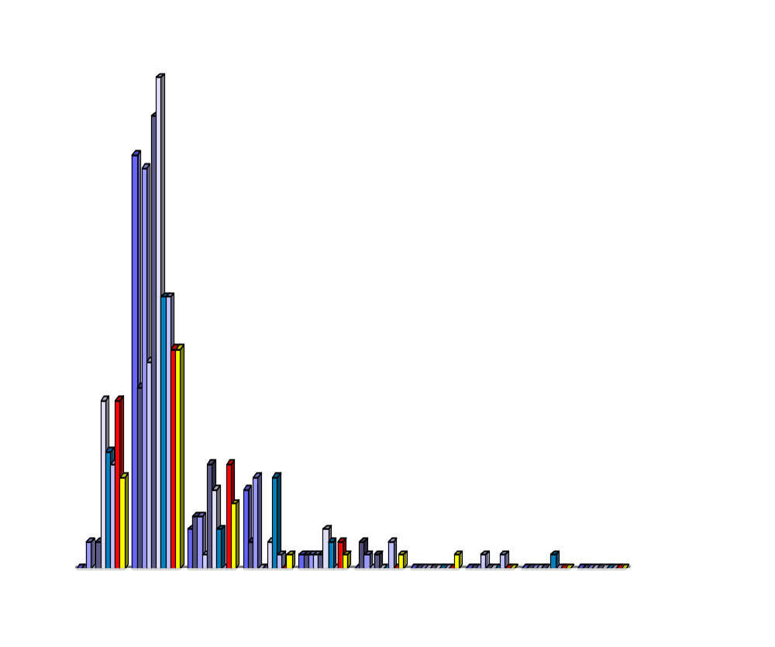
Histograms
A popular data reduction technique
Divide data into buckets and store average (sum) for each bucket
Can be constructed optimally in one dimension using dynamic programming
Related to quantization problems.
Lecture-16 - Data reduction

Slide 40
Clustering
Partition data set into clusters, and one can store cluster representation only
Can be very effective if data is clustered but not if data is “smeared”
Can have hierarchical clustering and be stored in multi-dimensional index tree structures
There are many choices of clustering definitions and clustering algorithms.
Lecture-16 - Data reduction

Slide 41
Sampling
Allows a large data set to be represented by a much smaller of the data.
Let a large data set D, contains N tuples.
Methods to reduce data set D:
  Simple random sample without replacement (SRSWOR)
  Simple random sample with replacement (SRSWR)
  Cluster sample
  Stright sample
Lecture-16 - Data reduction

Slide 42
Sampling
SRSWOR
(simple random
sample without
replacement)
SRSWR
Raw Data
Lecture-16 - Data reduction

Slide 43
Sampling
Raw Data
Cluster/Stratified Sample
Lecture-16 - Data reduction

Slide 44
Lecture-17
Discretization and concept hierarchy generation

Slide 45
Discretization
Three types of attributes:
  Nominal — values from an unordered set
  Ordinal — values from an ordered set
  Continuous — real numbers
Discretization: divide the range of a continuous attribute into intervals
  Some classification algorithms only accept categorical attributes.
  Reduce data size by discretization
  Prepare for further analysis
Lecture-17 - Discretization and concept hierarchy generation

Slide 46
Discretization and Concept hierachy
Discretization
  reduce the number of values for a given continuous attribute by dividing the range of the attribute into intervals. Interval labels can then be used to replace actual data values.
Concept hierarchies
  reduce the data by collecting and replacing low level concepts (such as numeric values for the attribute age) by higher level concepts (such as young, middle-aged, or senior).
Lecture-17 - Discretization and concept hierarchy generation

Slide 47
Discretization and concept hierarchy generation for numeric data
Binning
Histogram analysis
Clustering analysis
Entropy-based discretization
Discretization by intuitive partitioning
Lecture-17 - Discretization and concept hierarchy generation

Slide 48
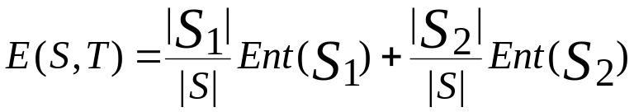

Entropy-Based Discretization
Given a set of samples S, if S is partitioned into two intervals S1 and S2 using boundary T, the entropy after partitioning is
The boundary that minimizes the entropy function over all possible boundaries is selected as a binary discretization.
The process is recursively applied to partitions obtained until some stopping criterion is met, e.g.,
Experiments show that it may reduce data size and improve classification accuracy
Lecture-17 - Discretization and concept hierarchy generation

Slide 49
Discretization by intuitive partitioning
3-4-5 rule can be used to segment numeric data into
relatively uniform, “natural” intervals.
* If an interval covers 3, 6, 7 or 9 distinct values at the most significant digit, partition the range into 3 equal-width intervals
* If it covers 2, 4, or 8 distinct values at the most significant digit, partition the range into 4 intervals
* If it covers 1, 5, or 10 distinct values at the most significant digit, partition the range into 5 intervals
Lecture-17 - Discretization and concept hierarchy generation

Slide 50
Example of 3-4-5 rule
count
Step 1:
-$351 -$159 profit $1,838 $4,700
Min Low (i.e, 5%-tile) High(i.e, 95%-0 tile) Max
Step 2:
msd=1,000 Low=-$1,000 High=$2,000
Step 3:
(-$1,000 - $2,000)
(-$1,000 - 0)
(0 -$ 1,000)
($1,000 - $2,000)
Step 4:
(-$4000 -$5,000)
(-$400 - 0)
(0 - $1,000)
($1,000 - $2, 000)
($2,000 - $5, 000)
(0 -
$200)
($1,000 -
$1,200)
(-$400 -
-$300)
($2,000 -
$3,000)
($200 -
$400)
($1,200 -
$1,400)
(-$300 -
-$200)
($3,000 -
$4,000)
($400 -
$600)
($1,400 -
$1,600)
(-$200 -
-$100)
($4,000 -
$5,000)
($600 -
$800)
($1,600 -
$1,800)
($1,800 -
$2,000)
($800 -
$1,000)
(-$100 -
0)
Lecture-17 - Discretization and concept hierarchy generation

Slide 51
Concept hierarchy generation for categorical data
Specification of a partial ordering of attributes explicitly at the schema level by users or experts
Specification of a portion of a hierarchy by explicit data grouping
Specification of a set of attributes, but not of their partial ordering
Specification of only a partial set of attributes
Lecture-17 - Discretization and concept hierarchy generation

Slide 52
Specification of a set of attributes
Concept hierarchy can be automatically generated based on the number of distinct values per attribute in the given attribute set. The attribute with the most distinct values is placed at the lowest level of the hierarchy.
country
15 distinct values
province_or_ state
65 distinct values
city
3567 distinct values
street
674,339 distinct values
Lecture-17 - Discretization and concept hierarchy generation

